Slide 1
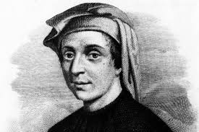

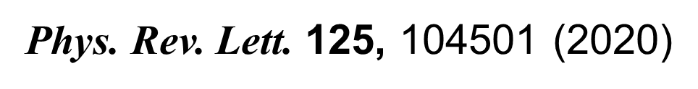

Information theory and Fibonacci turbulence
N Vladimirova, M Shavit and G Falkovich
arXiv:2101.10418

Slide 2
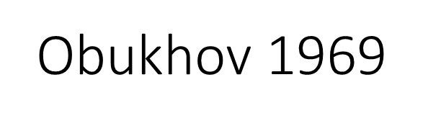
Hydrodynamic-type systems
Arnold 1966

Slide 3
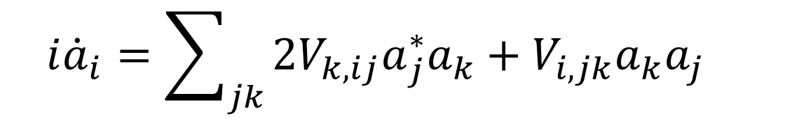
Hydrodynamic-type systems
Arnold 1966
$$i{\dot{a}}_{i}={\sum_{jk}{{{2V}_{k,ij}a}_{j}^{∗}a_{k}+V_{i,jk}a_{k}a_{j}}}_{}$$

Slide 4
Universal model of neighboring triplet interaction.
Hamiltonian
$F_{i} =\{1; 1; 2; 3; 5…\}$ are the Fibonacci numbers: $F_{i}{+F}_{i+1} =F_{i+2}$.

Slide 5

Weakly interacting waves

Slide 6
Weak turbulence theory
assuming initially Gaussian distribution and using the small parameter

Slide 7
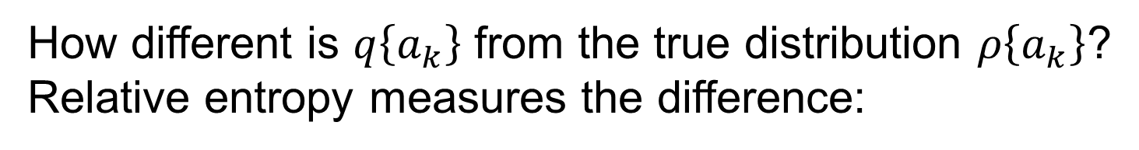
Wave system: Statistics of amplitudes
R Peierls, On the kinetic theory of thermal conduction in crystals, Ann. Phys. 3, 1055 (1929)
How different is $q\left\{a_{k}\right\}$ from the true distribution $ρ\left\{a_{k}\right\}$?
Relative entropy measures the difference:
It coincides with the mutual information between modes

Slide 8
$ρ\{a_{k}\} −$Weakly non-Gaussian distribution?

Slide 9
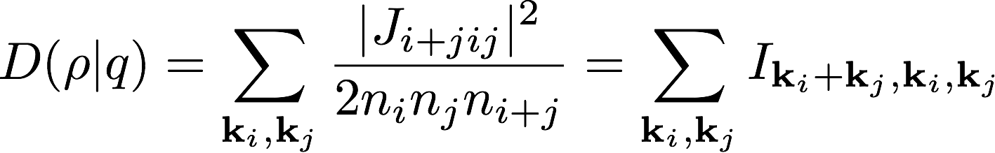
Relative entropy between the true distribution and the Gaussian approximation

Slide 10
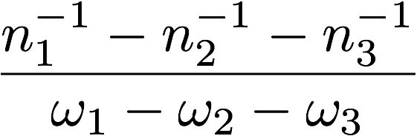
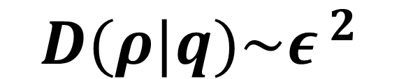
Thermal equilibrium
the third cumulant is regular everywhere in k-space for all times:
$$D(ρ|q)\sim {ε }^{2}$$

Slide 11
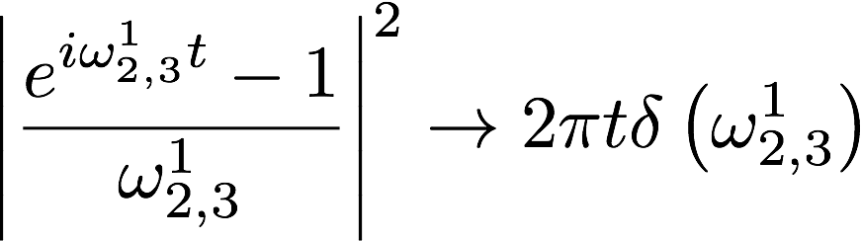
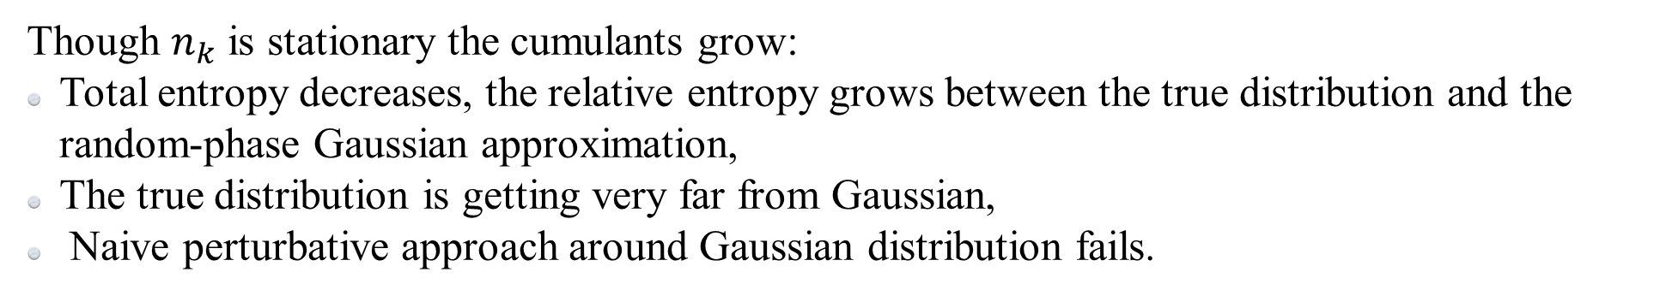

TURbulence
In turbulent probability distribution $ρ\left\{a_{k}\right\}$ the interaction energy
is weighted by the resonance factor
So the measure can become singular
D has a secular growth in weak turbulence:
Though $n_{k}$ is stationary the cumulants grow:
Total entropy decreases, the relative entropy grows between the true distribution and the random-phase Gaussian approximation,
The true distribution is getting very far from Gaussian,
Naive perturbative approach around Gaussian distribution fails.

Slide 12
Resonantly interacting waves

Slide 13
If pumping and damping are in a detailed balance

Slide 14
Resonant Fibonacci model
Family of conservation laws
Family of thermal equilibria

Slide 15
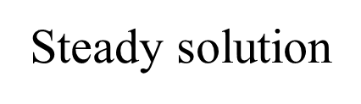
In a turbulent cascade, the fluxes of the quadratic invariants can be expressed via the third cumulant. Gauge invariance and Zeckendorf theorem ensure that only the cumulants of consecutive modes are nonzero:

Slide 16
Cascade direction?
Consider invariant subspace of solutions
Thermal equilibrium

Slide 17


$$α=0$$
$$α=1$$

Slide 19
Along the cascade, away from Gaussianity

Slide 21
One-mode statistics: entropy and anomalous scaling

Slide 22
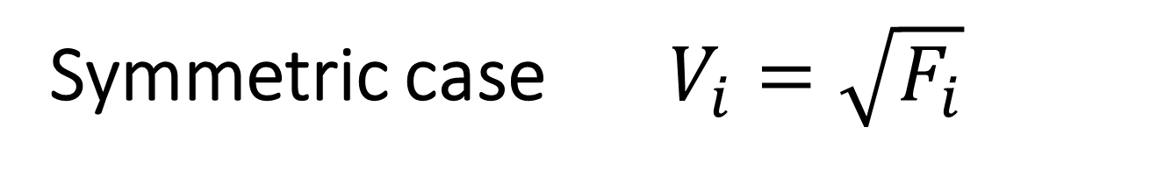
Symmetric case $V_{i}=\sqrt{F_{i}}$

Slide 24
The longer the interval, the smaller is the non-Gaussianity.
Might be amenable to perturbative renormalization group.

Slide 25
Where is the information encoded?
Disentangling information encoding can be done by structured groupings

Slide 26
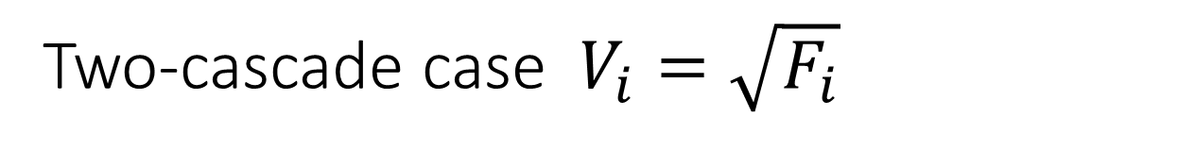
Two-cascade case $V_{i}=\sqrt{F_{i}}$

Slide 27
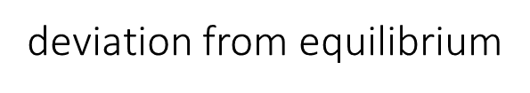
Dependence on the bin size
1-mode entropy
2-mode mutual information
3-mode interaction information

Slide 28
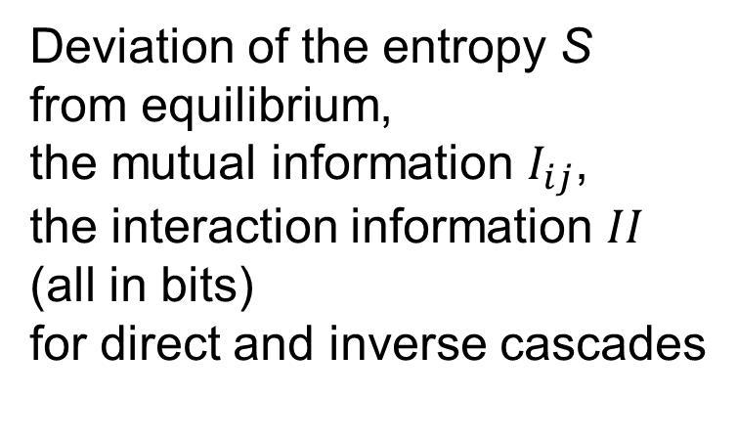
Deviation of the entropy S
from equilibrium,
the mutual information $I_{ij}$,
the interaction information $II$ (all in bits)
for direct and inverse cascades

Slide 29
The entropy of every mode decreases and the inter-mode correlations grow along the cascade. That diminishes the overall entropy comparing to the entropy of the same number of modes in thermal equilibrium with the same total energy.
One may then ask whether the entropy of turbulence is extensive (that is proportional to the number of modes) or there could be some "area law of turbulence", like for the entropy of black holes.

Slide 30
Kolmogorov multipliers

Slide 31
Kolmogorov multipliers
Conclusion: entropy is extensive
in turbulence as well.
Multipliers correspond to maximal entropy (most efficient encoding)

Slide 32
Kolmogorov multipliers
Conclusion: entropy is extensive
in turbulence as well.
Multipliers correspond to maximal entropy (most efficient encoding)

Slide 33
Kolmogorov multipliers
and scale invariance
Logarithm of the wave amplitude has scale invariant probability distribution.
How to relate it to the statistics of multipliers?

Slide 34
Dyson hierarchical model and RG?

Slide 35
Kolmogorov multipliers in turbulence and equilibrium
Assumption on independent Gaussian modes describes well the tails of the joint pdf of two multipliers

Slide 36
God created thermal equilibrium;
Demons do deviations.
We suggest information-THEORY TOOLS for turbulence analysis -.
the mutual information between different modes is parametrically larger in turbulence than in equilibrium
quality of turbulence modeling can be measured by the mutual information, whose maximum is the information capacity of turbulent cascade. How to use this information to improve DNS?
non-equilibrium measures are generally singular.
no-matter how small is nonlinearity and how close is then the statistics of amplitudes to Gaussian, the overall statistics is far from Gaussian, which is manifested in a large relative entropy.

Slide 37
Fibonacci model - the first case of a detailed information-theoretical analysis of turbulence in discrete models of strongly interacting systems.
Three types of cascades were found: single direct, double cascade and the first ever case of a single inverse cascade with an anomalous scaling.
Where the information (entropy deficit) is encoded?
For cascades close to equilibrium, most of the information is encoded is in irreducible triplet interaction information. Far from equilibrium, most of the information is encoded in pairs.
An important lesson is that measuring or computing mode amplitudes (or velocity structure functions) brings diminishing returns, that is less and less information, as one goes deep into the cascade. The maximal information is encoded in the statistics of the Kolmogorov multipliers. Most of that information is encoded in the statistics of a single multiplier; less than 10% is encoded in the correlation of neighbors. How to decode it is the task for the future.

Slide 38
Hydrodynamic-type systems
Arnold 1966
VSF 2020

Slide 39
Cascade direction?
Thermal equilibrium
Stability analysis

Slide 40
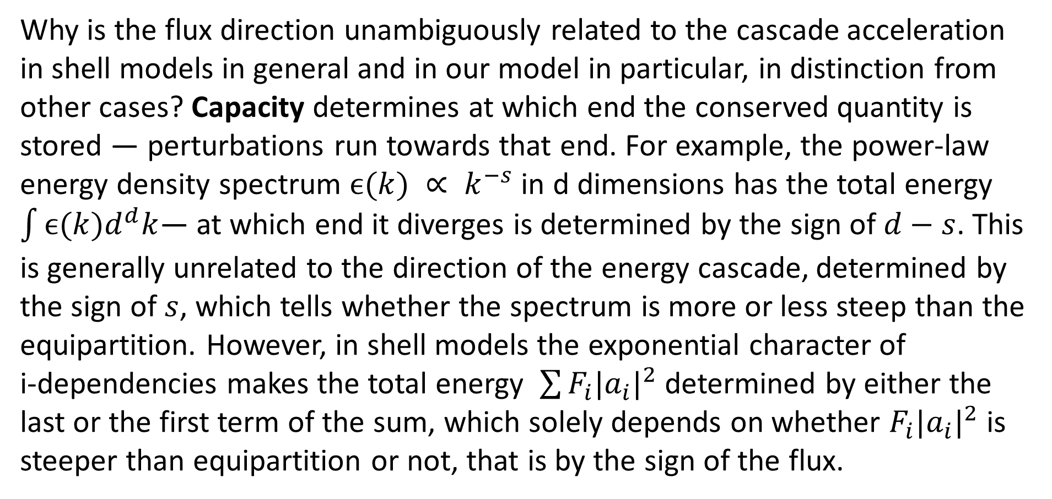
Cascade direction
Why is the flux direction unambiguously related to the cascade acceleration in shell models in general and in our model in particular, in distinction from other cases? Capacity determines at which end the conserved quantity is stored — perturbations run towards that end. For example, the power-law energy density spectrum $ϵ(k) ∝ k^{−s}$in d dimensions has the total energy $\int{ϵ(k)d^{d}k}$— at which end it diverges is determined by the sign of $d−s$. This is generally unrelated to the direction of the energy cascade, determined by the sign of $s$, which tells whether the spectrum is more or less steep than the equipartition. However, in shell models the exponential character of
i-dependencies makes the total energy $\sum{F_{i}|a_{i}|^{2}}$ determined by either the last or the first term of the sum, which solely depends on whether $F_{i}|a_{i}|^{2}$ is steeper than equipartition or not, that is by the sign of the flux.

Slide 41
Cascade direction

